Slide 1
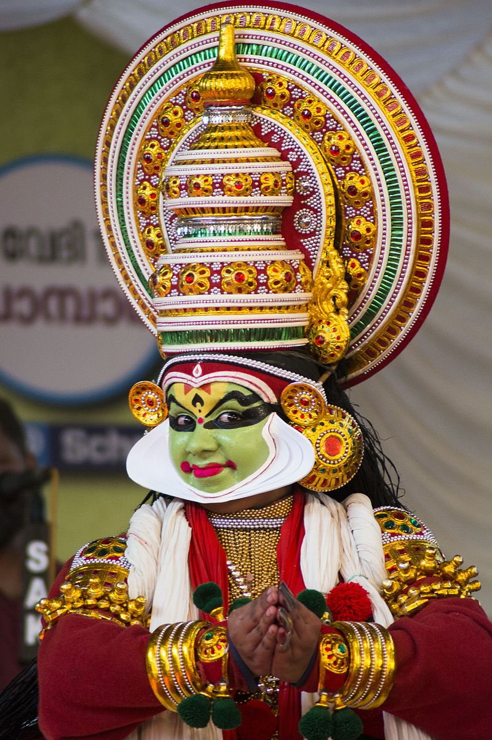
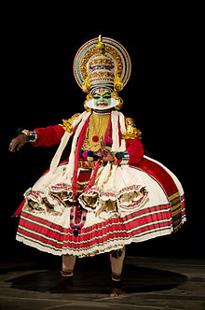
KATHAKALI
Purva Riviera
Girish S Kumar

Slide 2
KATHA KALI
STORY
PLAY

Slide 3
As a form of Performing arts
How did Kathakali started ?

Slide 4
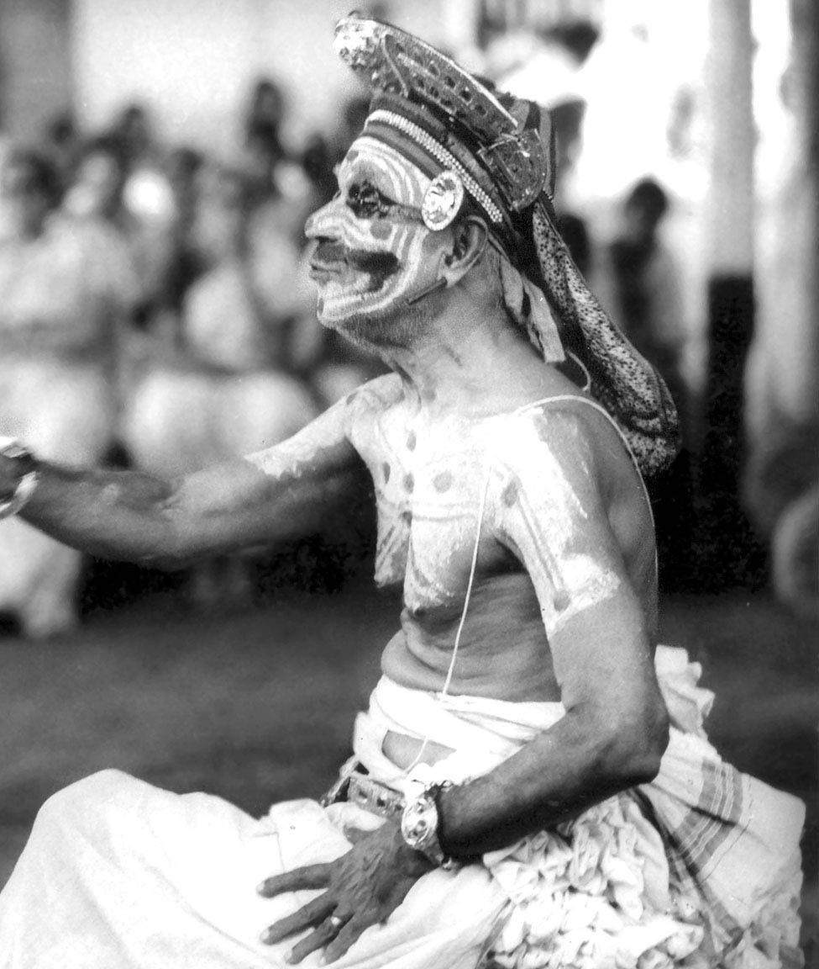
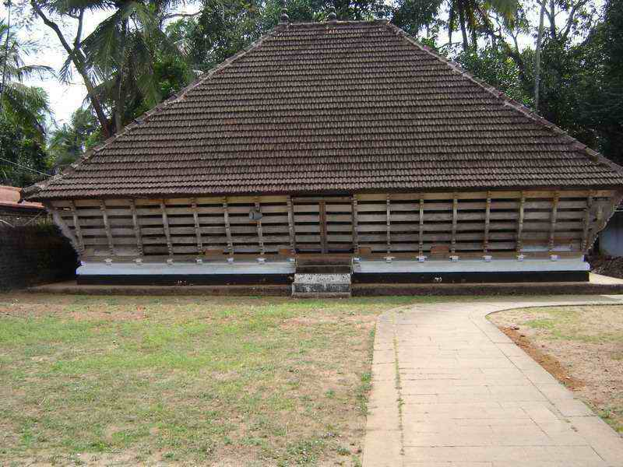
Koodiyattam
The earliest form of Classical dance From Kerala is called Koodiyattam Dating back to 2000 years in history – A form of dance performed in temples. Only form of art narrated 100% in Sanskrit

Slide 5
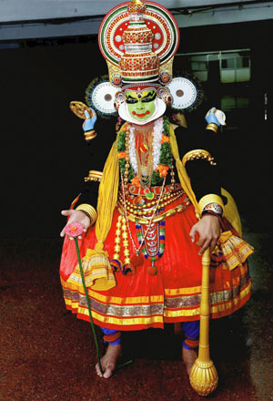
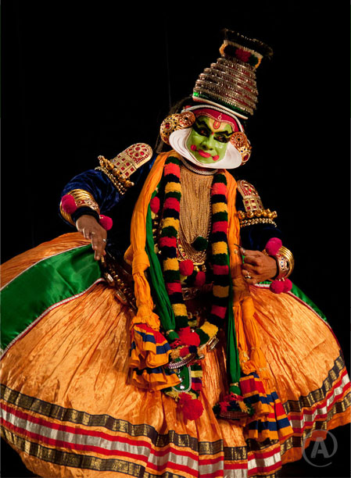
By late 1500 AD and early 1600 a new form of Classical dance called Krishnattam and Ramanattam came up which was performed in temples

Slide 6
Imagination and Creativity
is our birth right
This applied to Centuries old
form
of arts too…

Slide 7
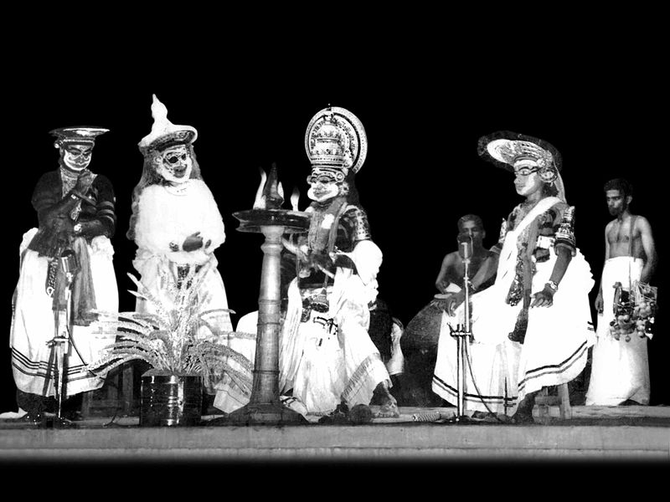
Taking ideas from
Existing form of classical dance
The earliest form of Kathakali appeared
In 1700 as an art performed in temples

Slide 8
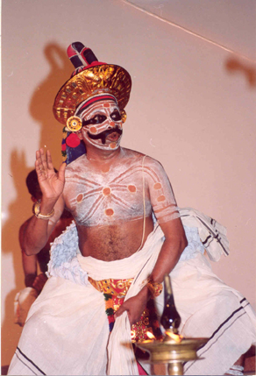
By 1800…. There were many classical dances

Slide 9
For the next one century Kathakali was slowly evolving with the creativity of artists
But it was limited to theaters in temples.

Slide 10
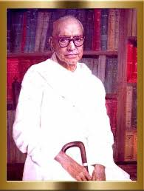
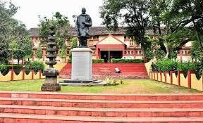
During 1930s a formal school for the Research & Development of Kathakali known as
Kerala Kala Mandalam was found by a noted scholar:
Vallathol Narayana Menon.
Today this is a Deemed University for all performing arts from Kerala

Slide 11
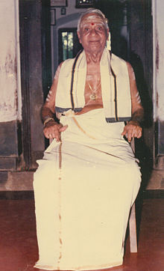
Early 1900 a sanskirt Scholar and a specialist in Natya Sastra from Kerala
Padma Sree Guru Mani Madhava Chakyar took Koodiyattam and Chakyar Koothu, Kathakali outside the precincts of the temples of Kerala to all over India he gave training in Kudiyattam & kathakali to all interested disciples including foreigners.
Made great contributions to Koodiyaatam and Kathakali and got universal acceptance around the world, which got him the Padmasree
He was known Emperor of Rasa-Abhinaya and Netrābhinaya
When Kerala Kalamandalam (a school for the performing arts) was founded by Vallathol Narayana Menon, invited authority of Rasa-abhinaya, Mani Madhava Chakyar as the master trainer for Rasa-abhinaya to the Kathakali students from all over the world.

Slide 12
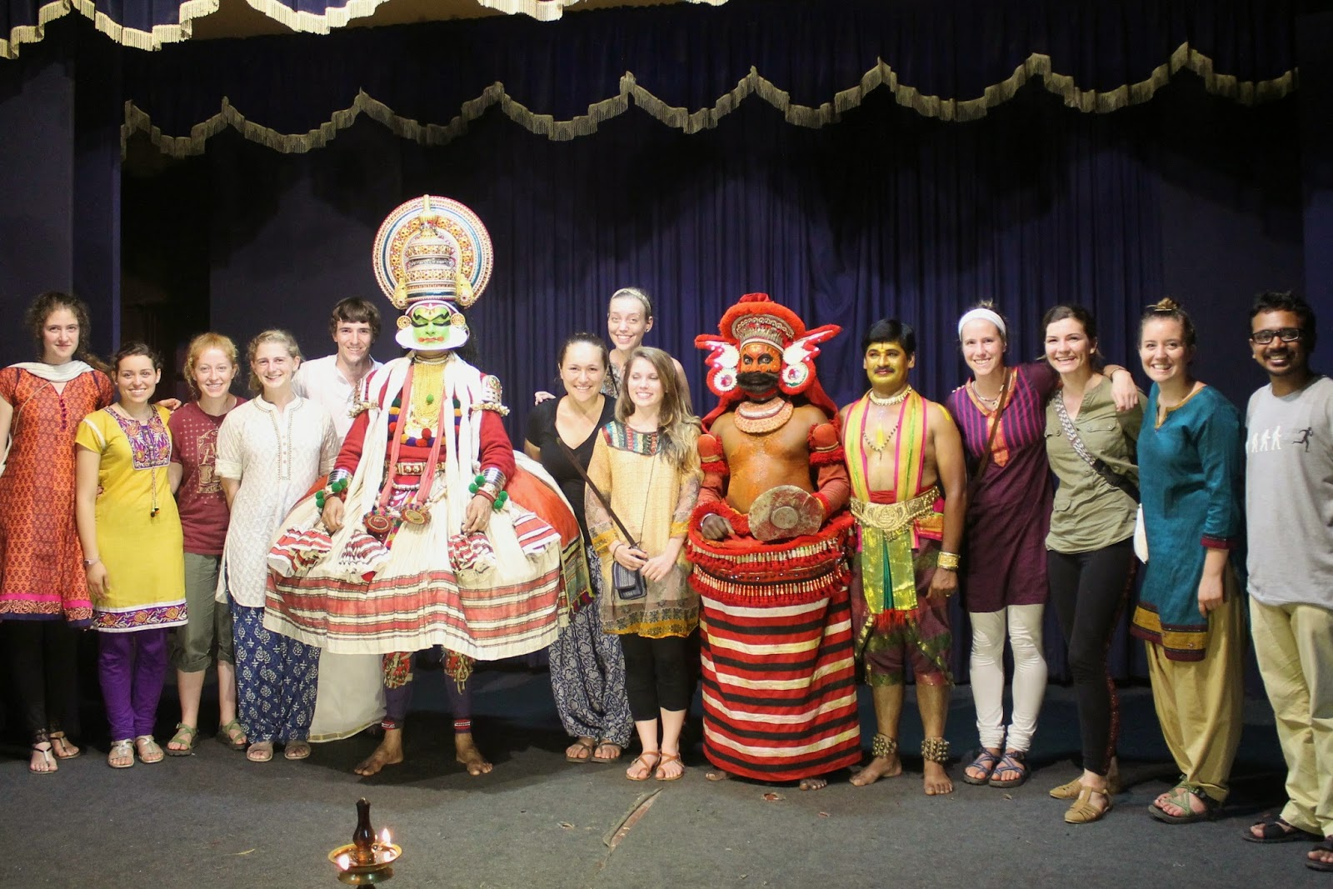
That opened up
Kathakali to the world
Farley Richmond and other scholars, Kathakali shares many elements such as costumes with ancient Indian performance arts such as Kutiyattam(classical Sanskrit drama) and medieval era Krishnanattam,

Slide 13
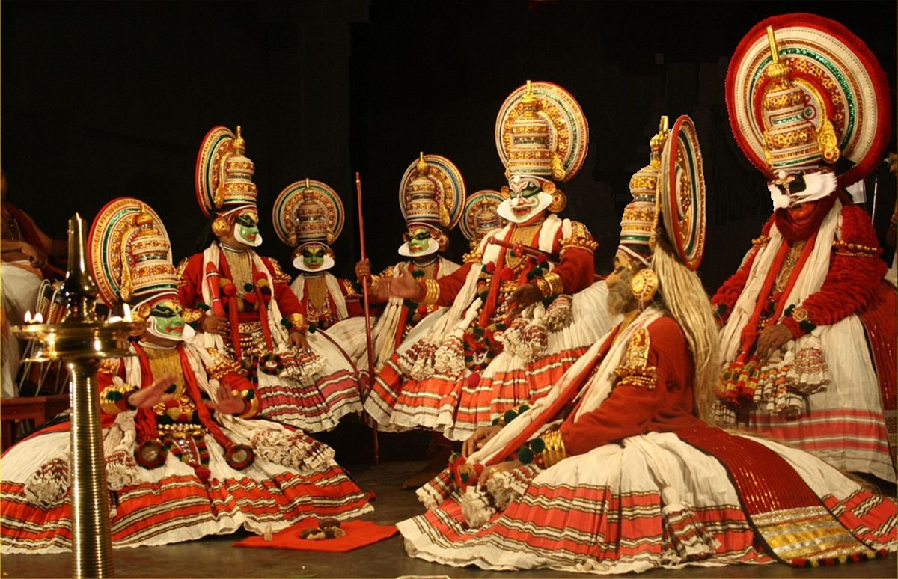
Kathakali is a combination of
Literature,
Music,
Painting,
Acting
Dance,
a beautiful mix of dance, drama and music.
Like all classical dance arts of India, Kathakali
Synthesizes music
Vocal performers
Choreography
Hand Gestures – Called Mudras
Facial gestures - Called Bhavas
Costumes
Kathakali differs for other classical dances
that it incorporates movements from ancient Indian martial arts and athletic traditions of South India

Slide 14
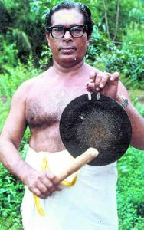
Vocal Performers
Vocal performance in Kathakali is called
Kathakali Padangal
Each “Padam” is a poem recited in one of the Karnatic music ragas. Aattakkadhakal (stories for dance), Sanskitised Malayalam.
The orchestra in it is composed of two vocal musicians, one keeping time with a resounding gong called chegala and the other with a pair of clanking cymbals called elethalam

Slide 15
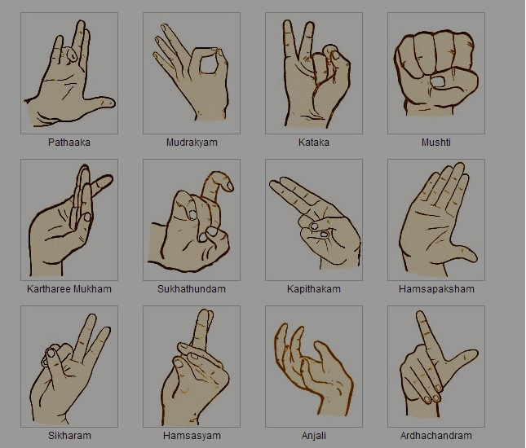
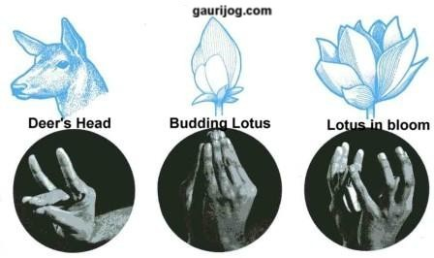
Hand Gestures - Mudras

Slide 16
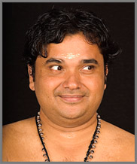
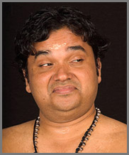
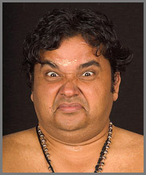
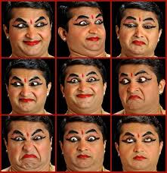
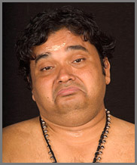
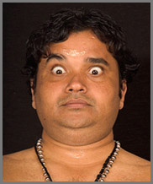
Facial Gestures -Navarasas
Sringara-Love
Hasya-Comedy
Beebhatsa-Disgust
Karuna-Pity
Raudra-Furious

Slide 17
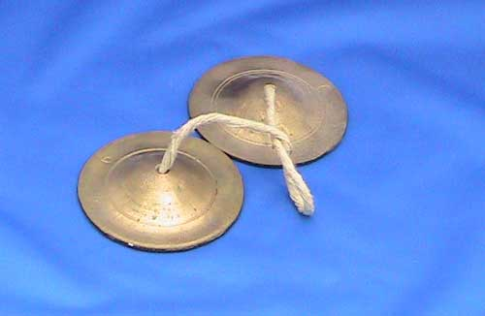
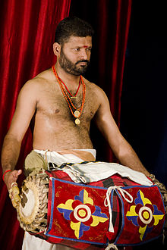
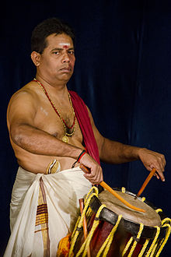
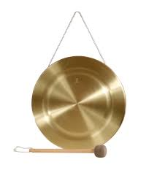
Musical Instruments

Slide 18
Costume - Vesham
No | Name | Description
1 | Pacha (Green)- | portrays noble protagonists like King Nalan from Nalacharitham, Lord Rama, Arjuna etc.
2 | Kathi (Knife)- | portrays villainous characters like Duryodhanan in Mahabharata
3 | Thadi (Beard)- | There are three types of bearded or Thadi Veshams.
4 | "Vella Thadi" | White beard for superhuman monkeys like Hanuman.
5 | "Chuvanna Thadi" or | Red beard is for evil characters like Bali in Balivadham, Rakshasas, Asuras etc
6 | "Karutha Thadi" or | Black beard for the hunter like the Kattalan in Nalacharitham and Kiratham Kathakali.
7 | Kari (Black) - | used for lady-demons (witches in Indian epic) like Poothana
8 | Minukku (Prettying Up)- | used for female characters and sages - Damayanthi, Bhanumathi.

Slide 19
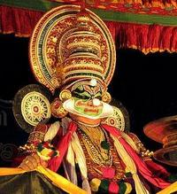
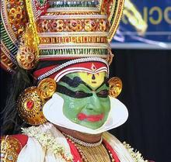
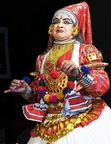
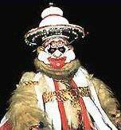
portrays noble protagonists
Arjuna im Mahabharatha
Kathi: characters like Duryodhanan in Mahabharata
Minukku: characters like Draupathi in Mahabharata

Slide 20
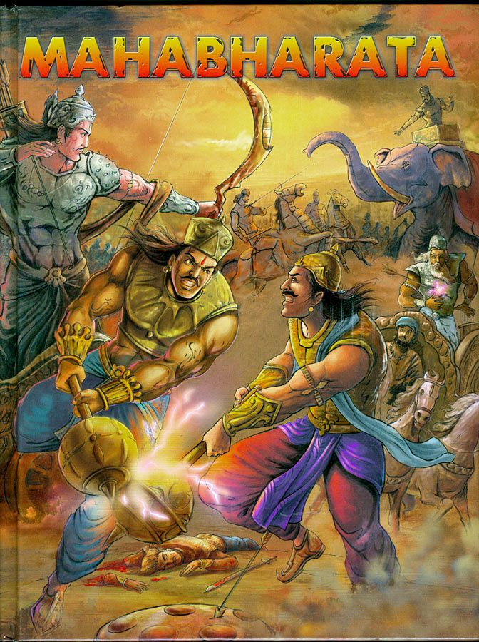
A leaflet from Mahabharatha were Dushansan was killed at Kurkeshtra by Bheema

Slide 21
To enjoy Kalthakali
You need to know the story what is
played

Slide 22
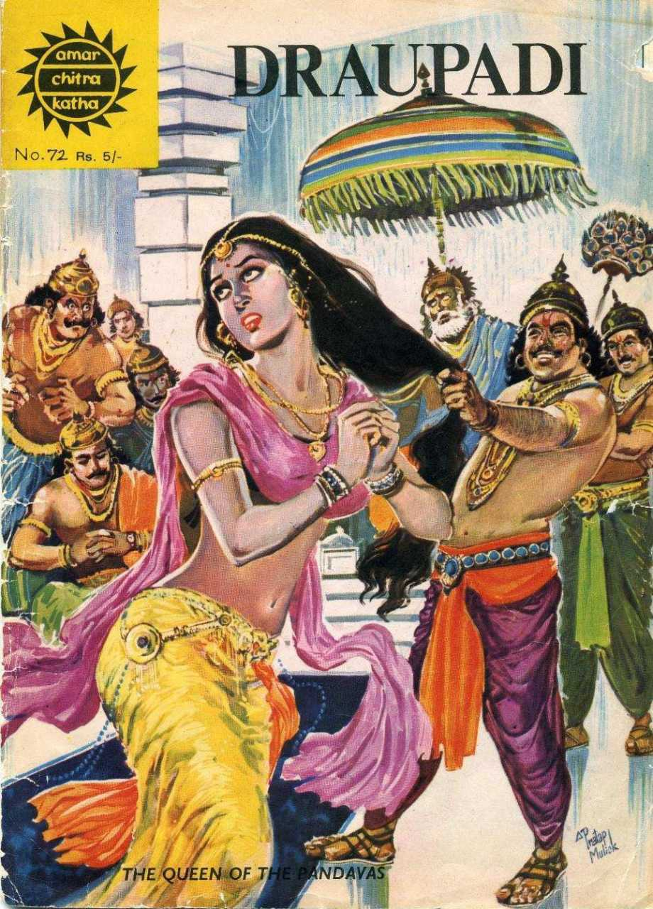

Slide 23
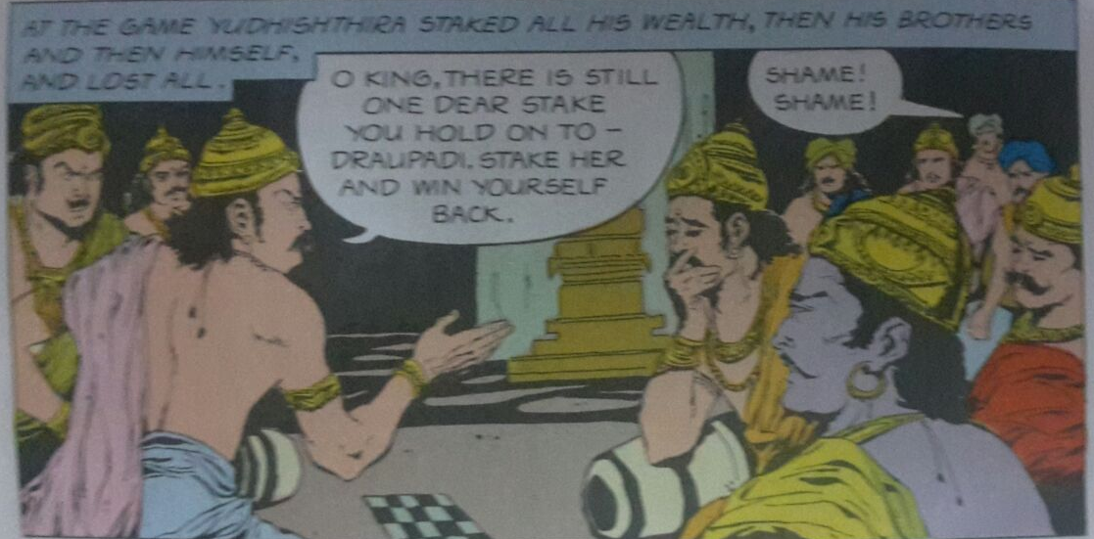

Slide 24
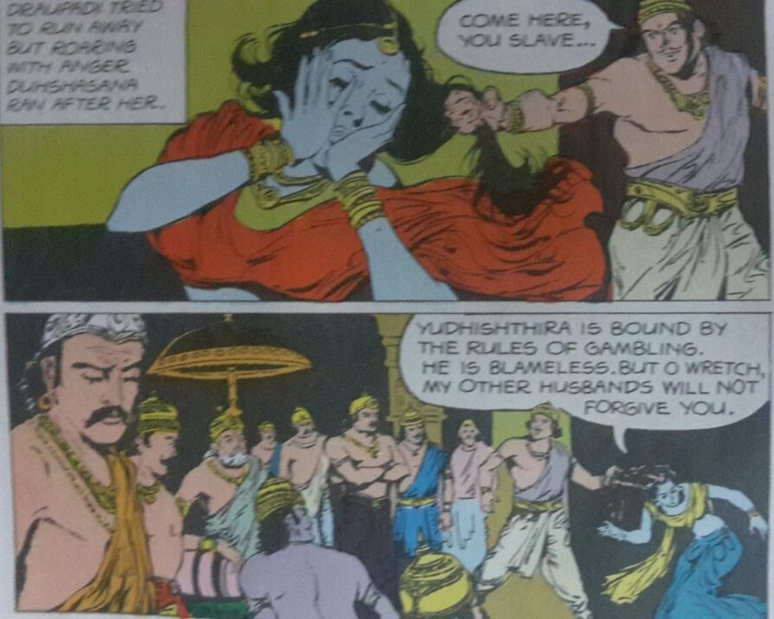

Slide 25
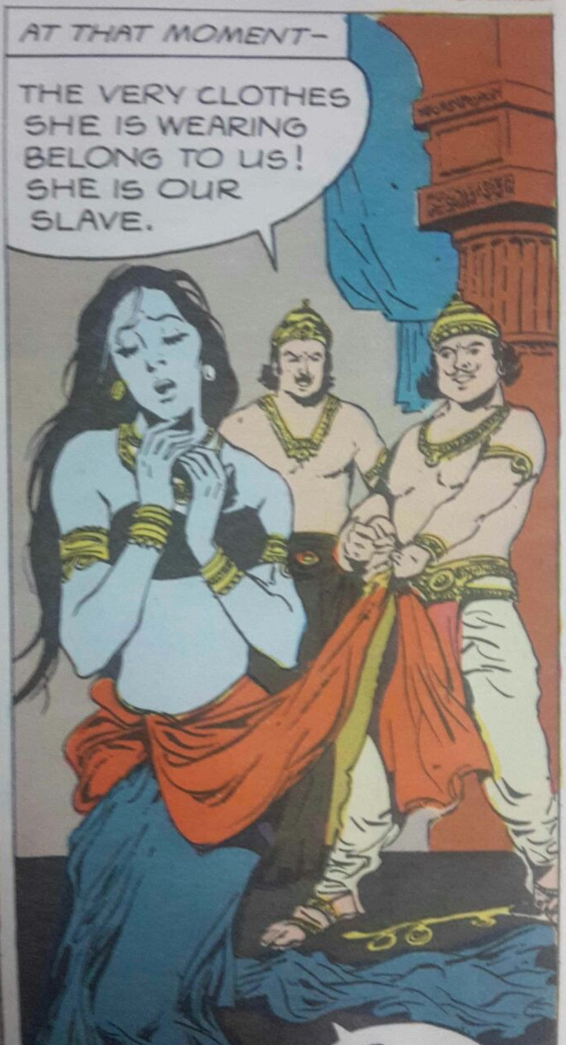

Slide 26
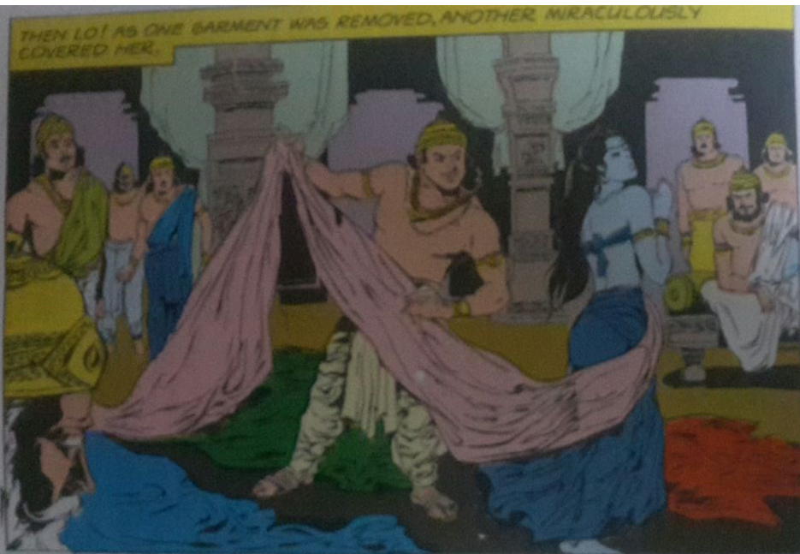

Slide 27
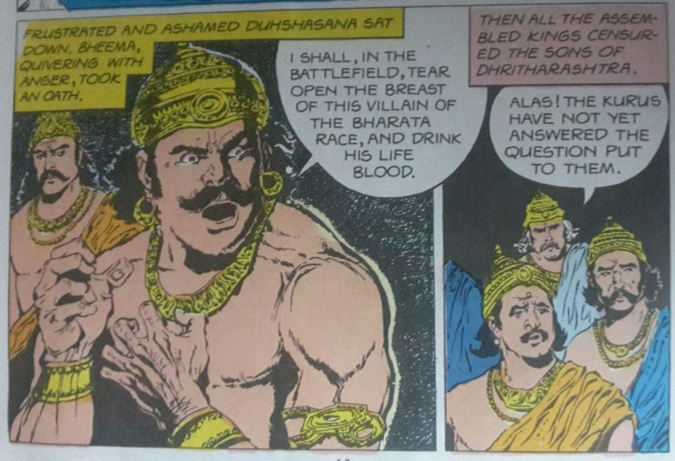

Slide 28
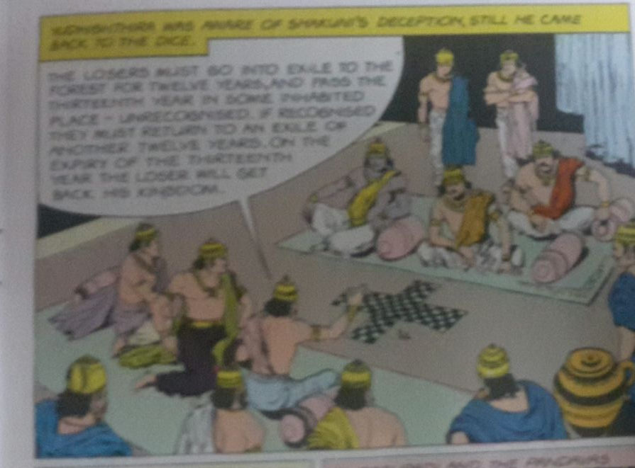

Slide 29
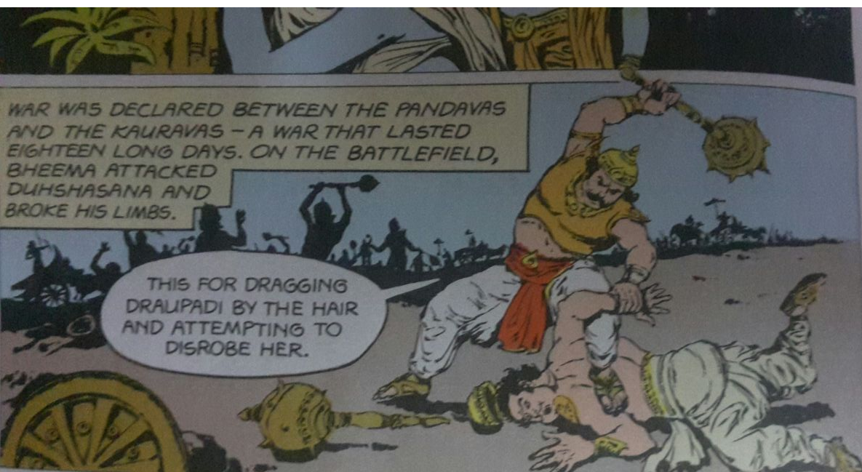

Slide 30
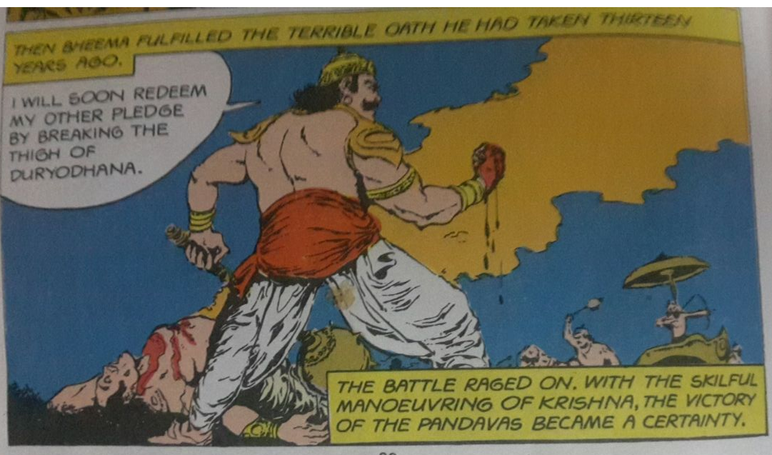

Slide 31
Artists (Kathakali school – Thrisoor)
No | Name | Role
1 | Narayanan Kutty | Acting as Dushasanan (Kathi)
2 | Mukundan | Acting as Drupathi (Minukku)
3 | Ravi Kumar | Bheema (Vella Thadi)
4 | Vishwas and Vivek | Vocal – Kathakali Padangal
5 | Srirag, Prashanth and | Musical Instruments (Chenda Madalam)
6 | Rakesh | Costume
7 | Mohammad and Sethumadhavan | Green Room, all the support activates
All the Artists are Degree holder s in Kathakali from Kerala Kalalmandalam – A deemed University under the Ministry of Arts and Culture.

